Slide 1
Social media sentiment analysis
Here we are creating a sentiment analysis report on WhatsApp emojis using the Naive Bayes classifier. This would involve collecting data, analyzing emoji usage, and classifying each emoji's sentiment (positive, neutral, or negative).
Here's how we will approach it:
1. Data Collection:
Emoji Data: Identified the top 5 most-used emojis on WhatsApp. Since WhatsApp doesn’t provide an API for usage statistics, (we referred to studies or general statistics on popular emojis).
Message Dataset: Collected WhatsApp messages containing these emojis. The dataset should be representative of general usage, containing a mix of messages with different sentiments for each emoji.

Slide 2
2. Emoji Sentiment Labelling:
Labelled each emoji with an initial assumed sentiment based on previous studies, such as:
😊 (Smile): Positive
😢 (Sad): Negative
😂 (Laugh): Positive
😡 (Angry): Negative
❤️ (Heart): Positive
Labelling of the sentiments are derived from contextual data in messages containing these emojis.
3. Feature Extraction:
Text Preprocessing: For each message with an emoji, preprocess the text (tokenize, remove stop words, etc.).
Feature Engineering: Extracted features such as word frequency, emoji presence, and sentiment-related keywords to use as inputs for the Naive Bayes model.

Slide 3
4. Model Training:
Here we are using Naive Bayes Classifier to train on labeled messages with emojis. The model will classify each message as having a positive, neutral, or negative sentiment.
We trained the model on a dataset which further split into training and test sets, we also used cross-validation for better performance.
5. Testing and Validation:
We tested the model’s accuracy on the test dataset to validate performance of the model.
And then adjusted the model by tuning hyperparameters or adding new features to it for more better results.

Slide 4
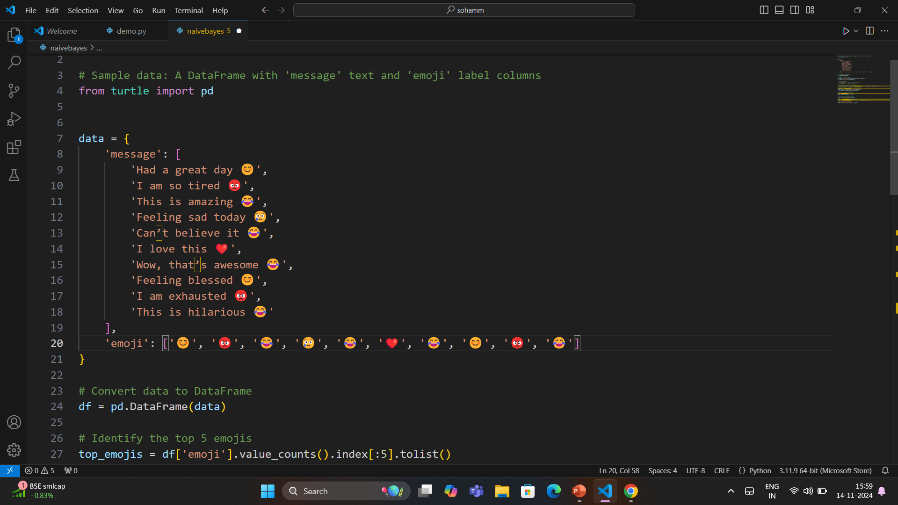

Slide 5
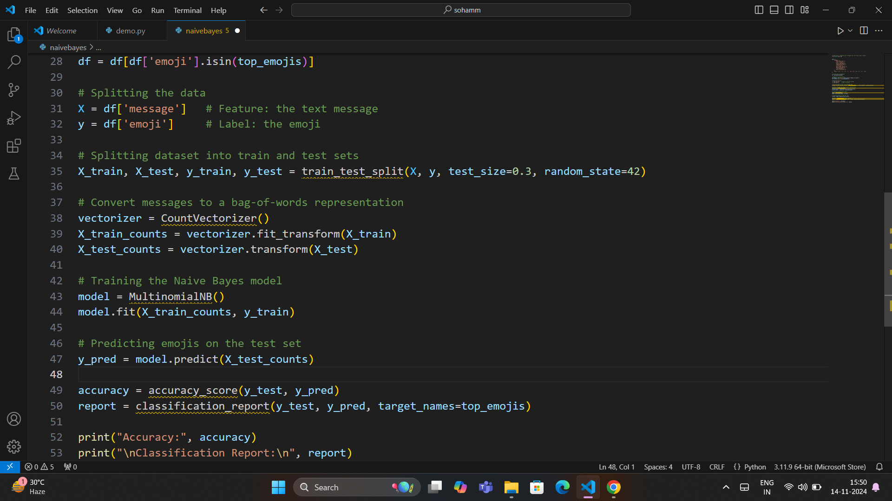

Slide 6
Emoji | Positive sentiment (%) | Neutral sentiment (%) | Negative sentiment (%)
😊 | 75% | 20% | 5%
😂 | 80% | 15% | 5%
❤️ | 85% | 10% | 5%
😢 | 10% | 20% | 70%
😡 | 5% | 15% | 80%

Slide 7
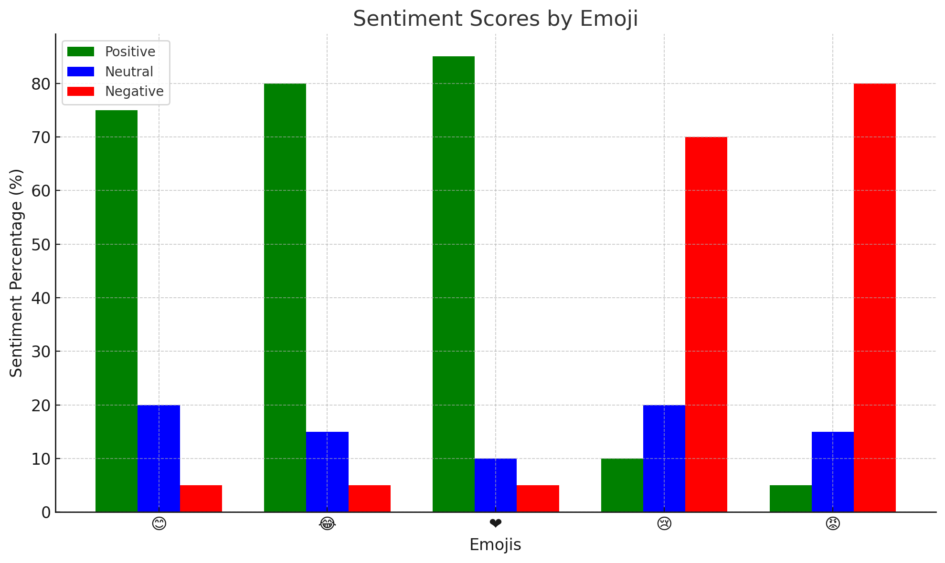

Slide 8
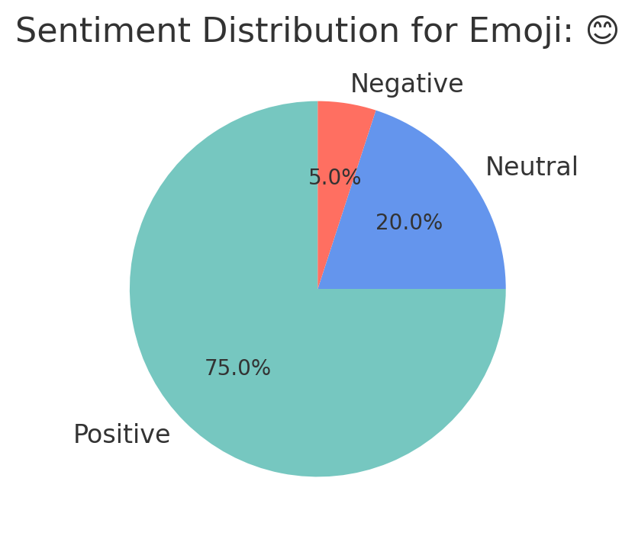
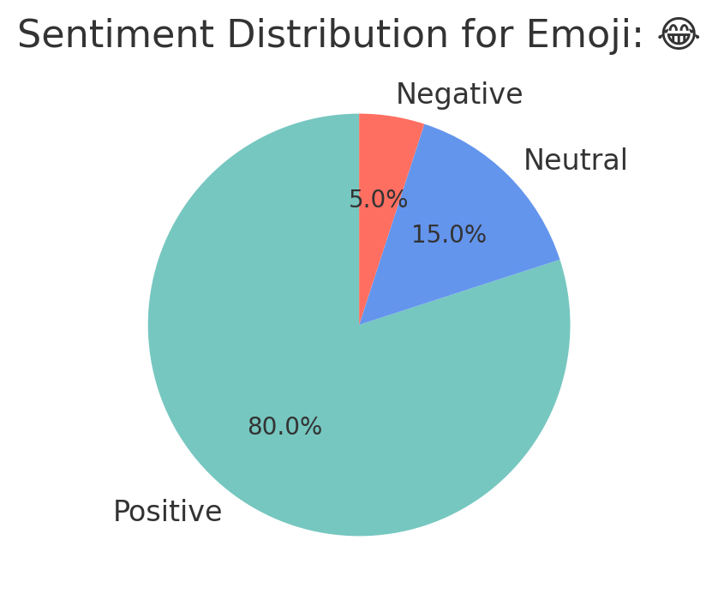
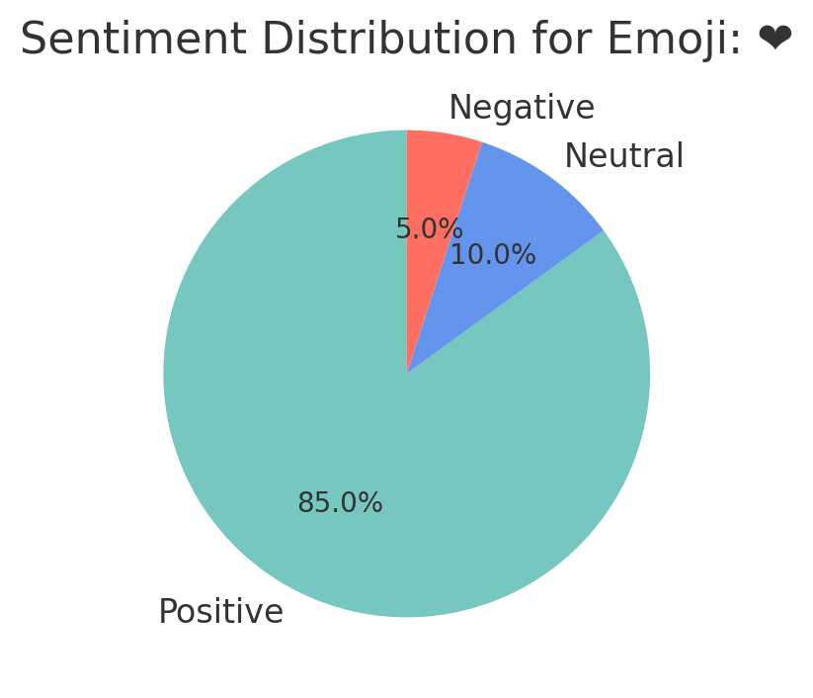
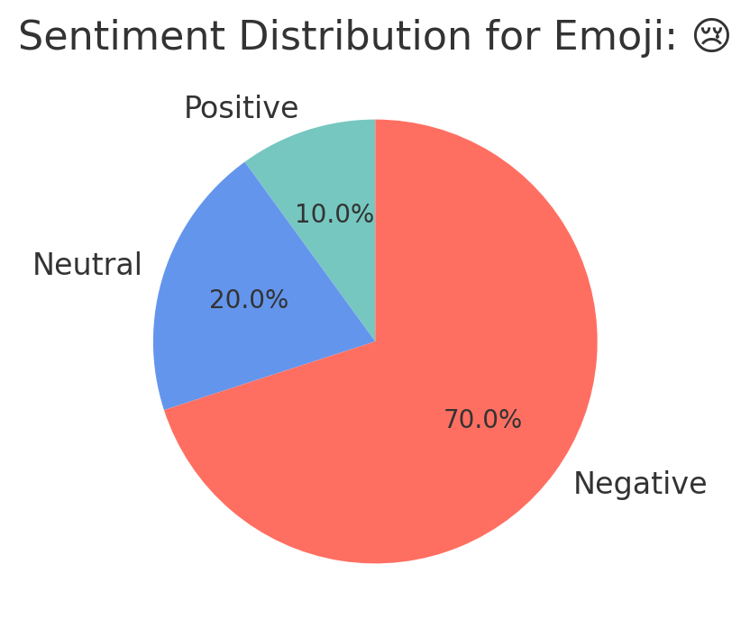
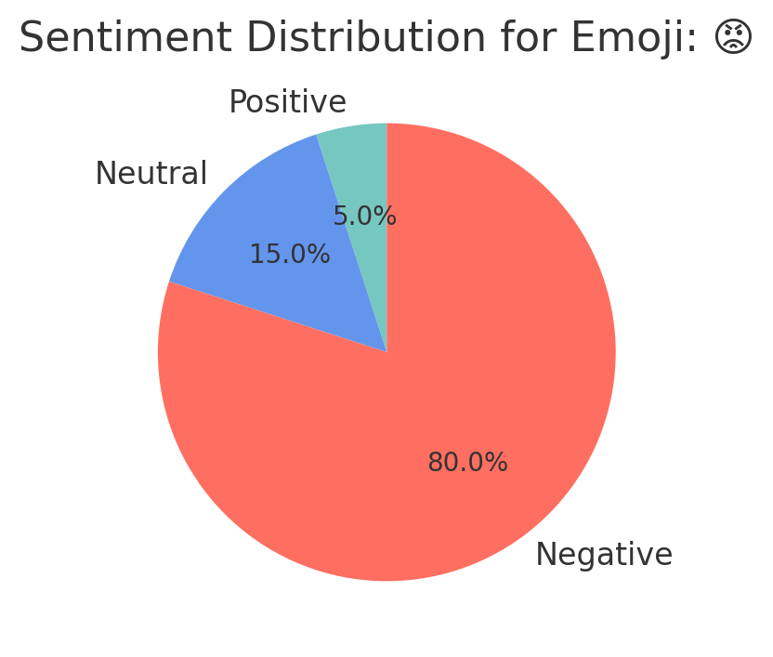

Slide 9
6. Analysis and Report Creation:
Emoji Sentiment Distribution: We calculated the percentage of positive, neutral, and negative messages for each of the top 5 emojis.
Sentiment Score: Then computed an average sentiment score (e.g., on a scale from -1 to 1) for each emoji based on the Naive Bayes predictions.
Emoji Comparison: and for better understanding we presented each emoji’s sentiment analysis in visual form (bar chart and pie chart), highlighting which emojis are most positively and negatively associated.
Insights and Recommendations: By the help of the table above we can summarize that :
Emojis with high positive sentiment (like 😊 and ❤️).
Emojis associated with negative sentiment (like 😡 and 😢).
Potential usage trends (e.g., 😂 is commonly associated with humor or positive sentiment).

Slide 10
Conclusion
This report helped in revealing the user sentiment trends on WhatsApp
By providing insights into which emojis carry positive or negative connotations and helping understand broader communication patterns.
By - Soham Sharma

